Slide 1




Good coding practices, publishing your work and code-collaboration (#213)
Eurotox
Ljubljana, sep 2023
Alyanne de Haan, Marie Corradi, Marc Teunis University of Applied Sciences Utrecht

Slide 2
an essentials workflow for Reproducible research
Note for github-downloaders: please also read the comments ☺
This work is licensed under a Creative Commons Attribution-NonCommercial-ShareAlike 4.0 International License.
CC BY-NC-SA 4.0

Slide 3
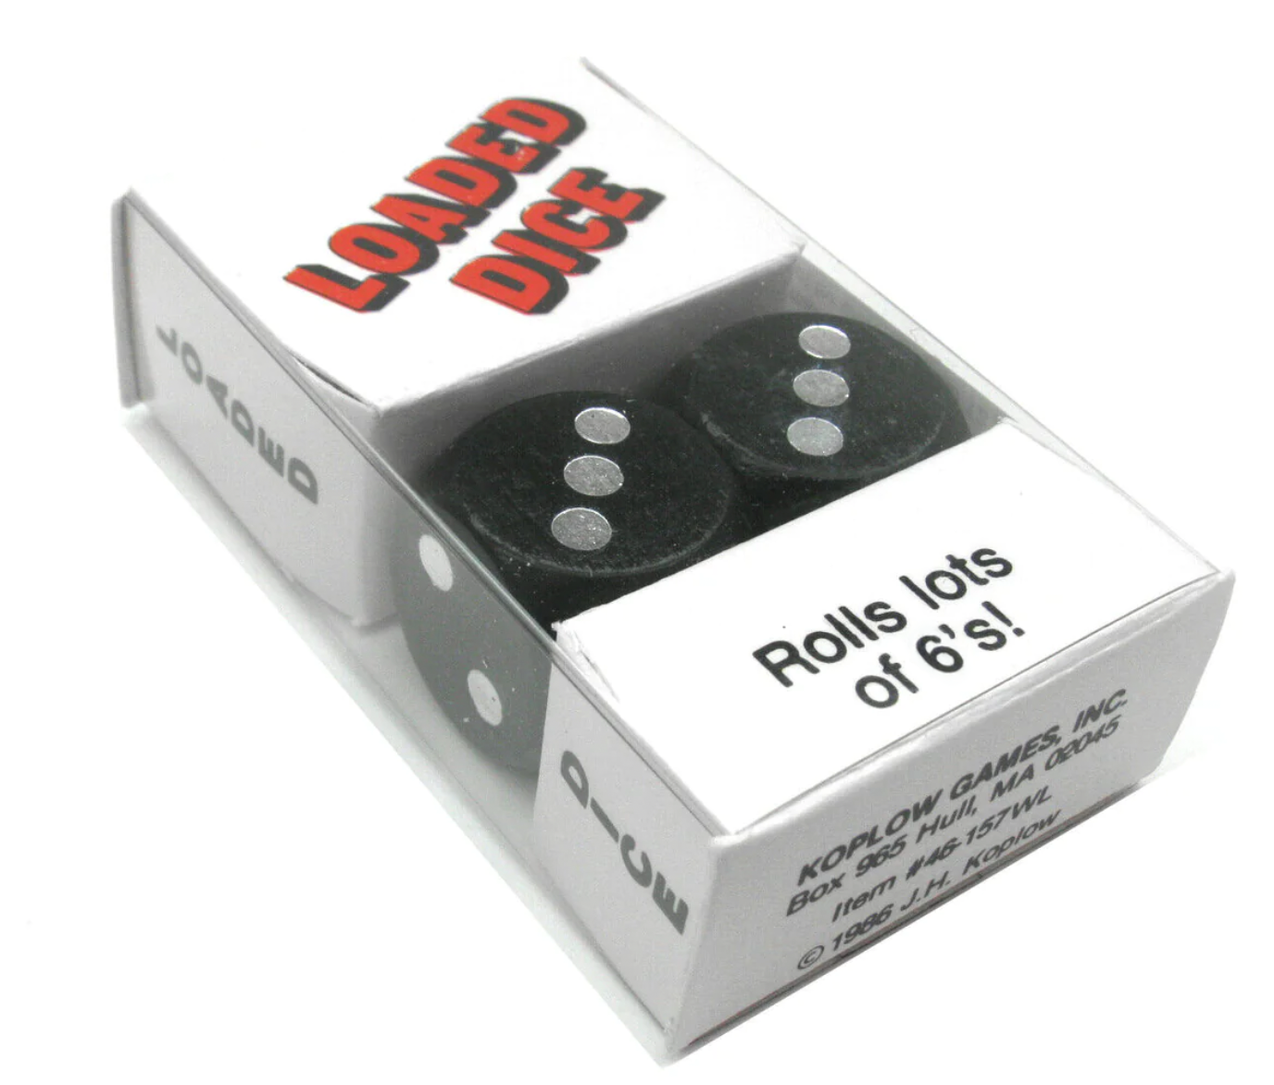
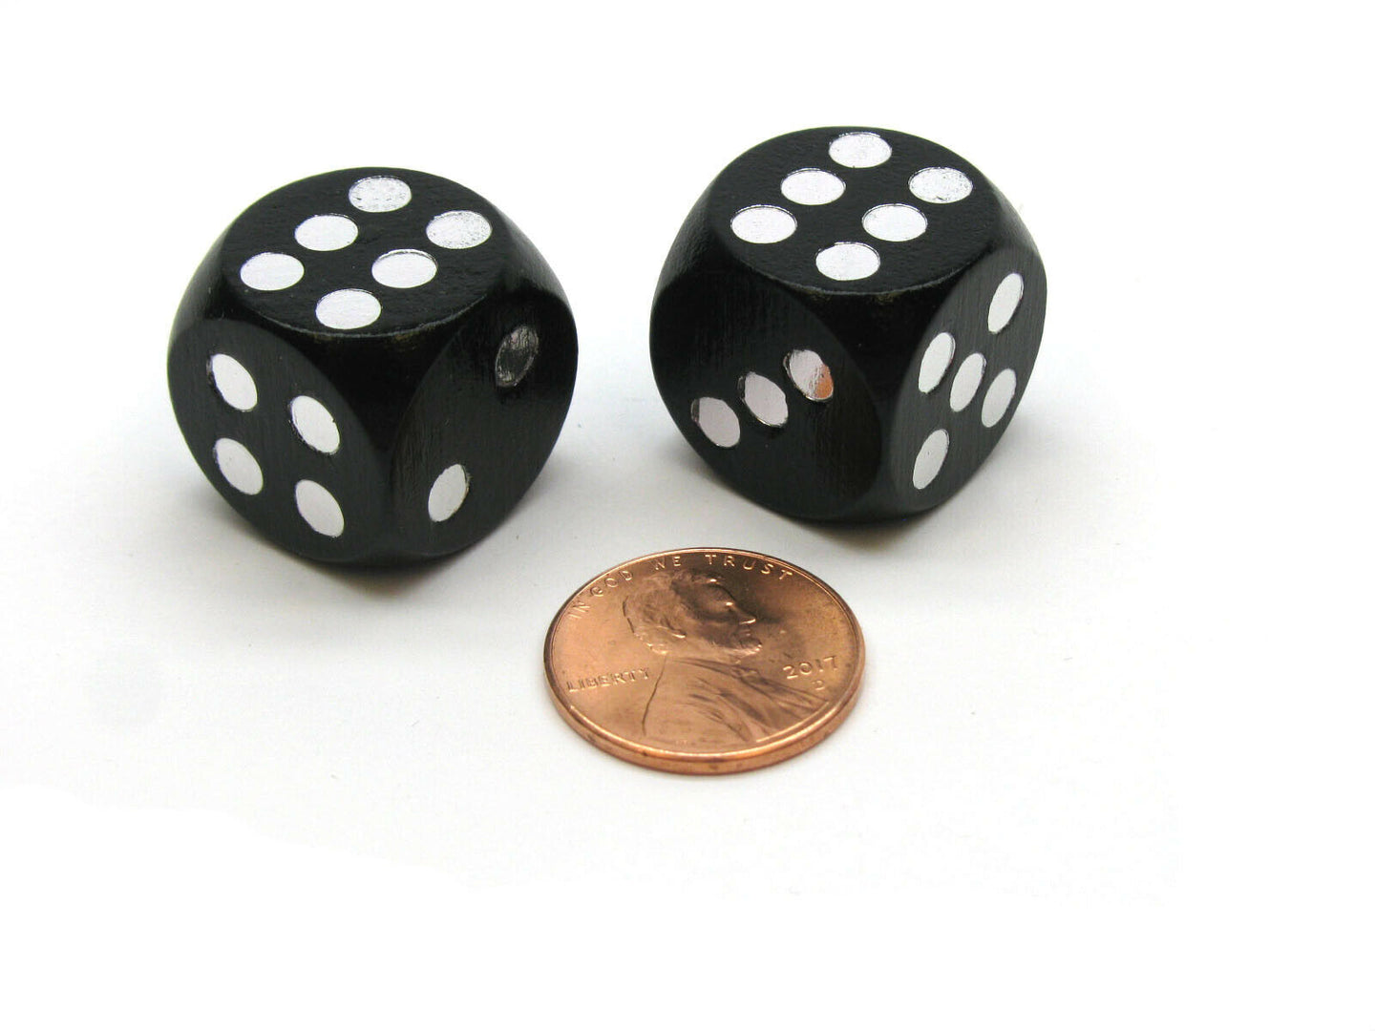
Notes:
Prior info is important

Slide 4
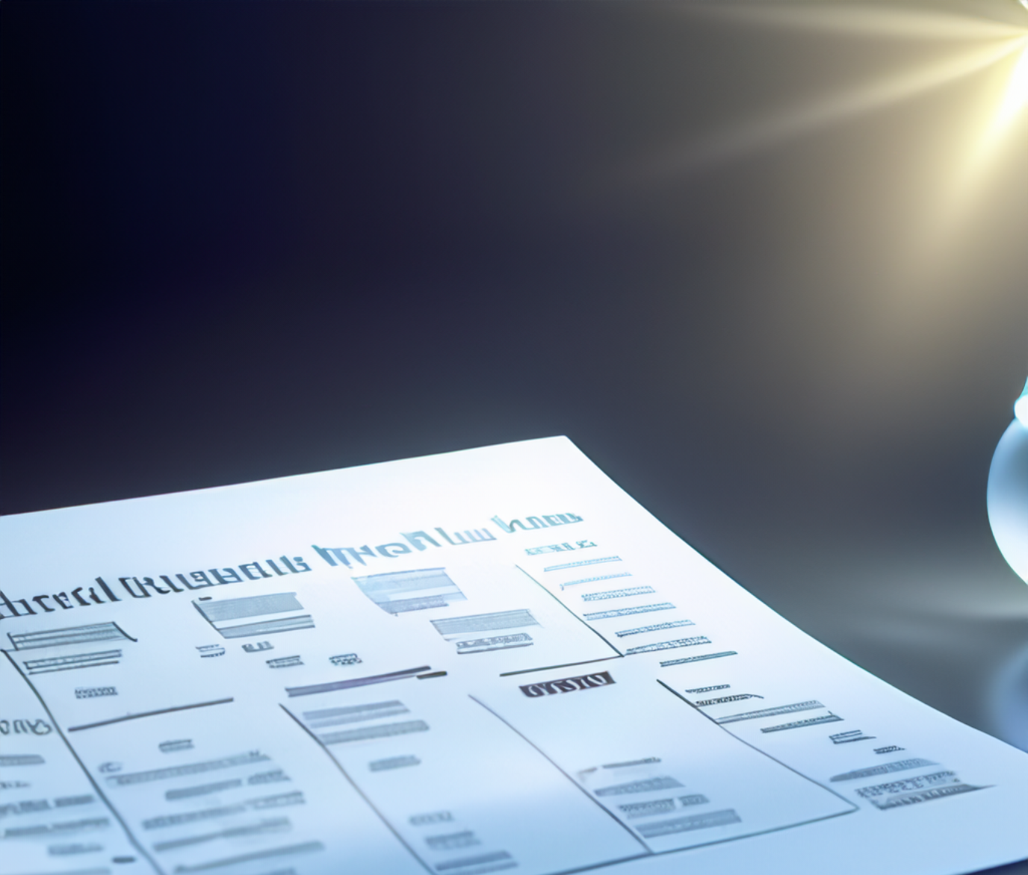
Introduction with our prior (context)
Methods (shop, weight, safety info, informed consents etc)
→ replicable
Notes:
And we know this. We write papers with introductions explaining our prior beliefs or expectations and background. The context of a study, if you like. And elaborate methods sections, explaining where I got the dice, weight of the dice, previous papers using the same dice, safety information regarding the dice, informed consents… Anyone who would want to throw these dice themselves should be able to do so. This is replicability. Which in reality is still often quite hard, but in any case: we try really hard and it is part of our normal workflow.

Slide 5
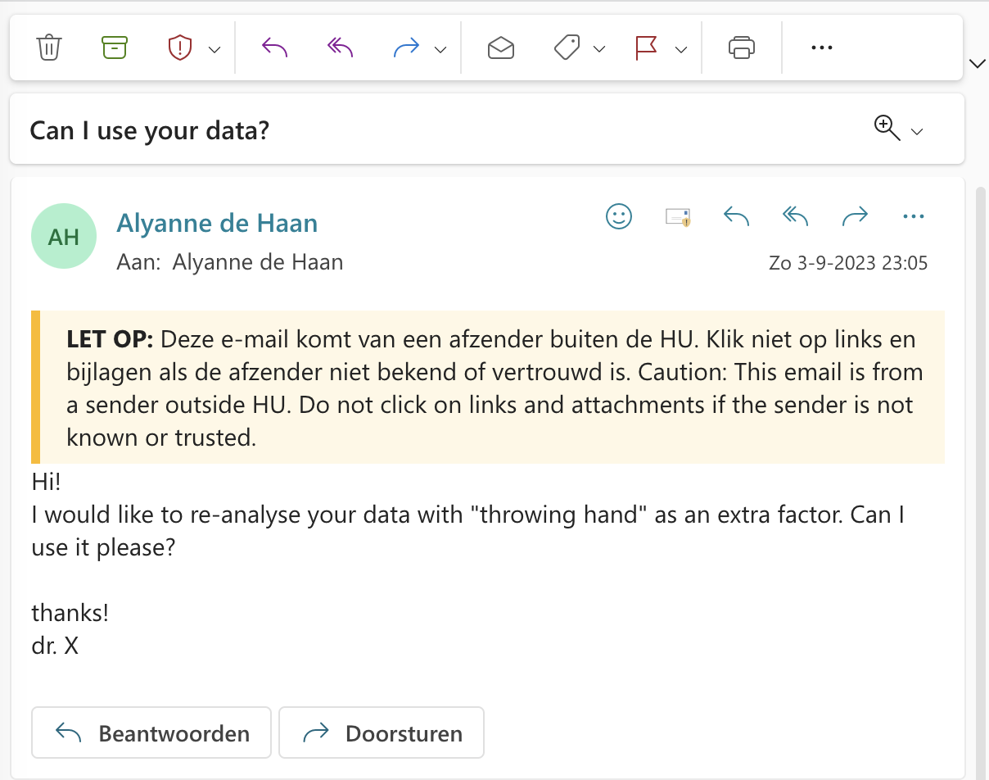
Dr X
Notes:
Now suppose someone sends me an email, saying “listen, I have this idea that it should matter which hand you are using. Can I re-analyse your data, with “throwing hand” as an extra factor?”

Slide 6
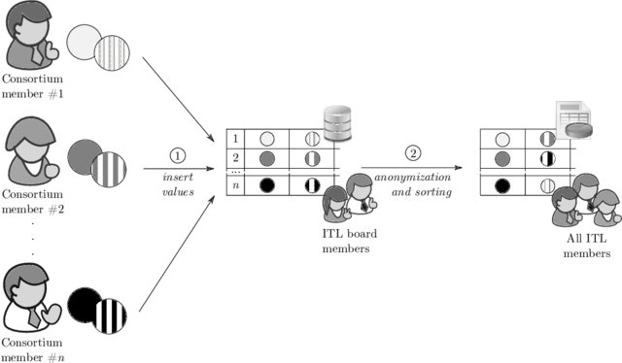
Image: Bogdanov, Dan & Talviste, Riivo & Willemson, Jan. (2011). Deploying Secure Multi-Party Computation for Financial Data Analysis. IACR Cryptology ePrint Archive. 2011. 662. 10.1007/978-3-642-32946-3_5.
Notes:
Or perhaps we start a consortium, such as Ontox, Riskhunter or Precisiontox. And we have multiple people in different groups making predictions.

Slide 7
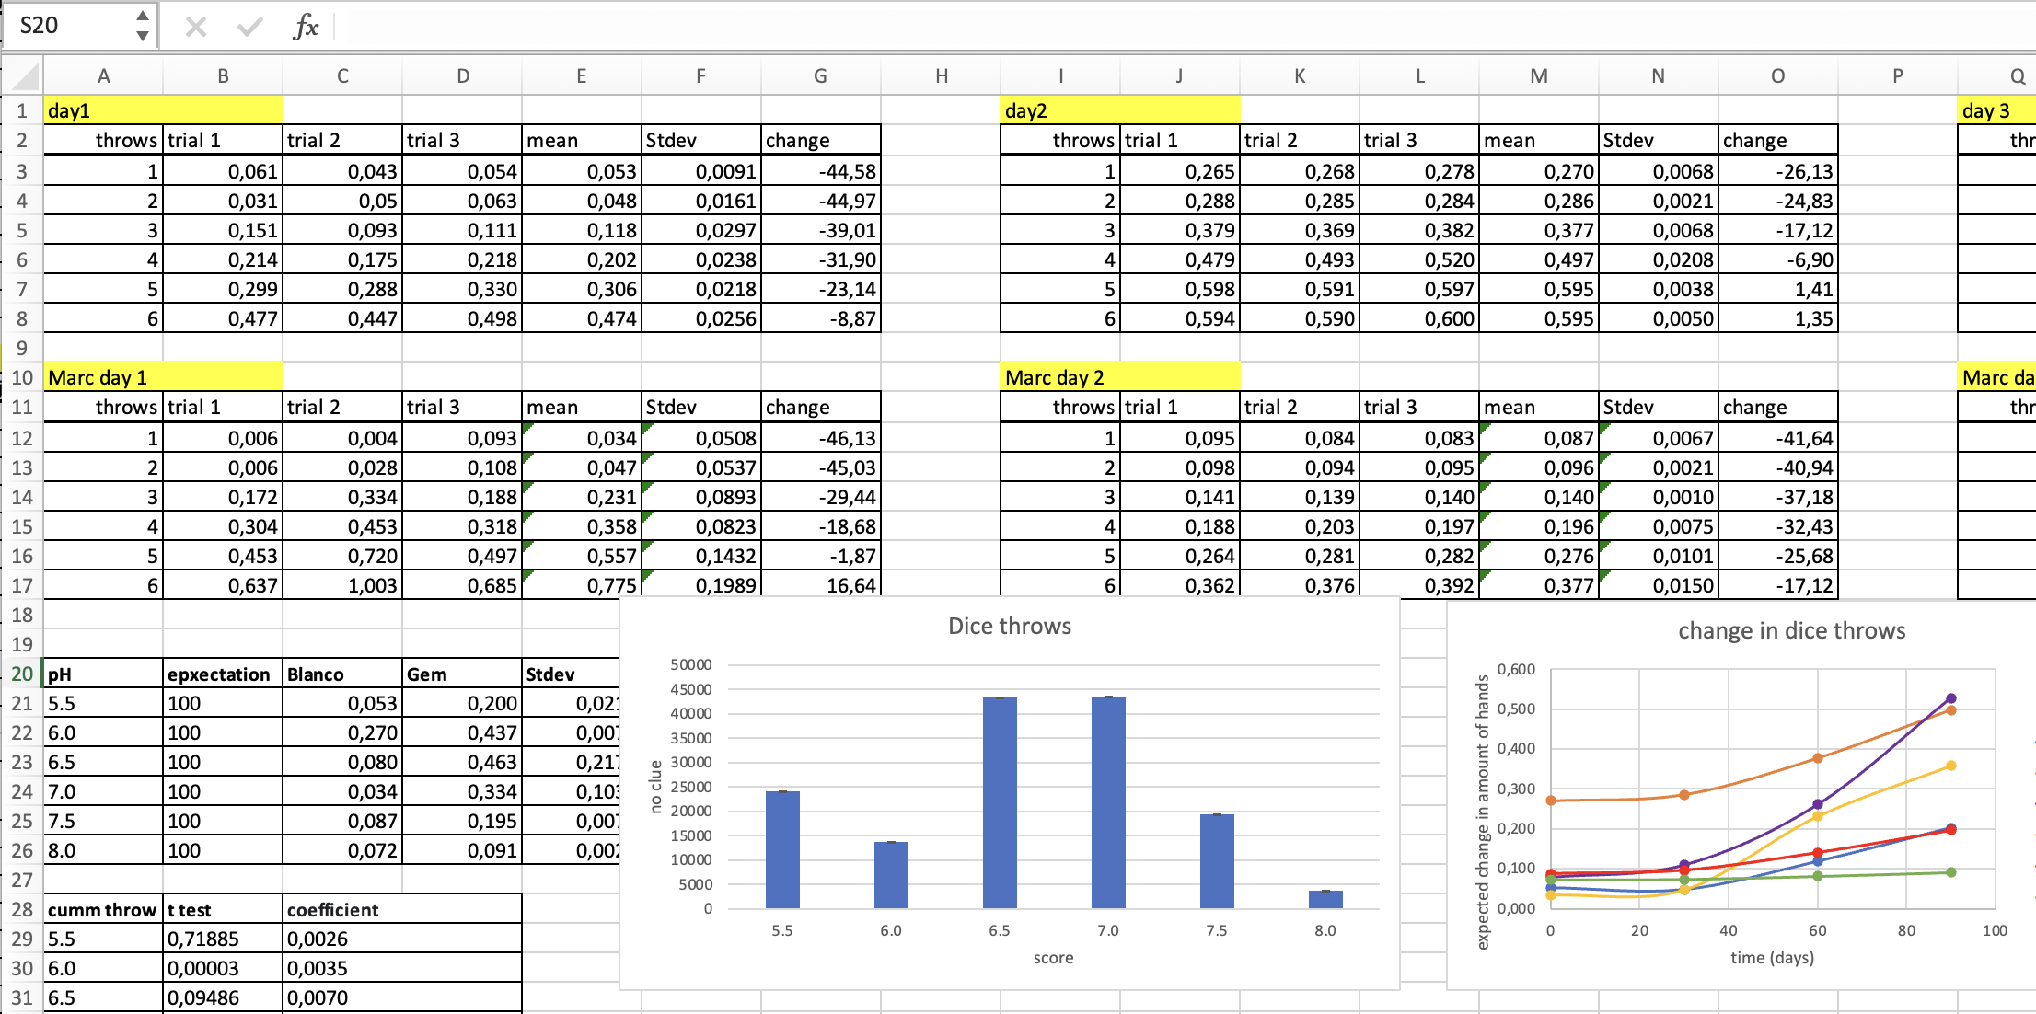
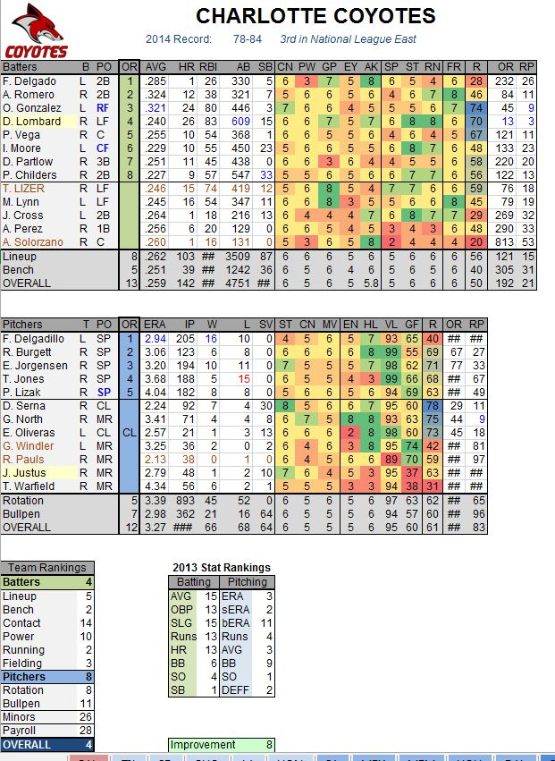
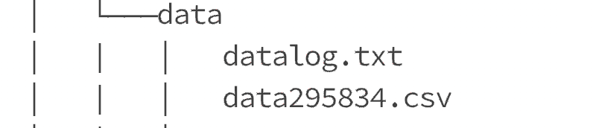
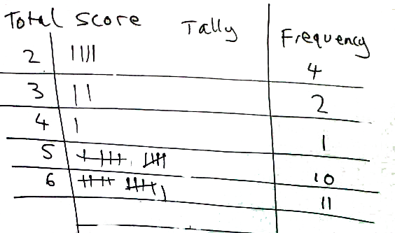
dice_data_day1till6.xlsx
dice_day8till20.xlsx
Dice_day8till20_may.xlsx
Dicedata_combined_april.xlsx
Dice_data_backup.xlsx
Day7.xlsx
Notes:
This is quite often a bottleneck

Slide 8

Why don’t we do this

Slide 9
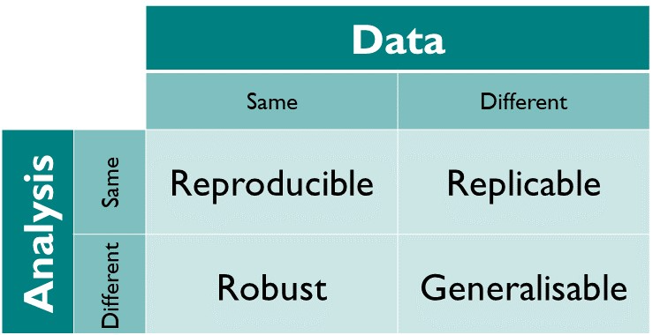
Problem in reproducibility
Kirstie Whitaker, University of Cambridge, Creative Commons Attribution license CC-BY 4.0.
Notes:
We are trained very well in replicability. But not yet on reproducibillity.
We don’t mean to make a mess. But we are just not given credit for really clean laptops. We get credit for writing papers, teaching nice classes, working fast.

Slide 10
Some Motivations we already know:
- collaboration
- help future you remember how and why you performed specific analyses
- help future you / a colleague do similar analyses on different data
- data lineage, trust
- save confusion = time (= money)
Notes:
Motivation is not enough.

Slide 11
So what is stopping us?
imposter syndrome, underestimation, and workflow

Slide 12

The realm of our laptops
Notes:
We are getting into personal space. We don’t like people to come this close.
We like to double, triple check everything that is going out there.
We do not like to show people the contents of our laptops.

Slide 13
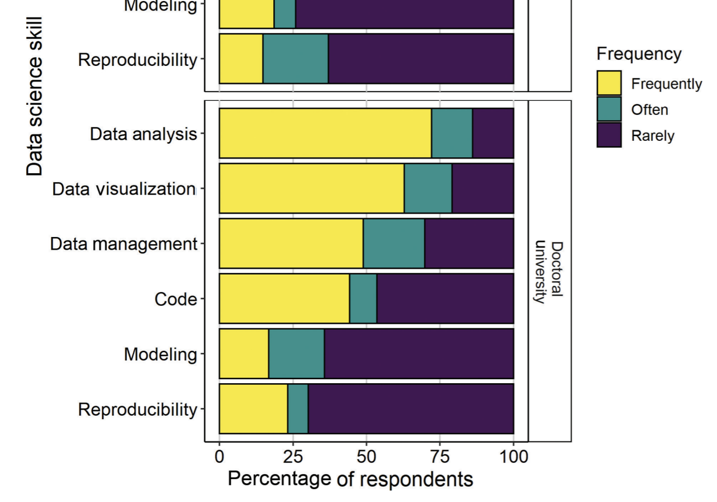
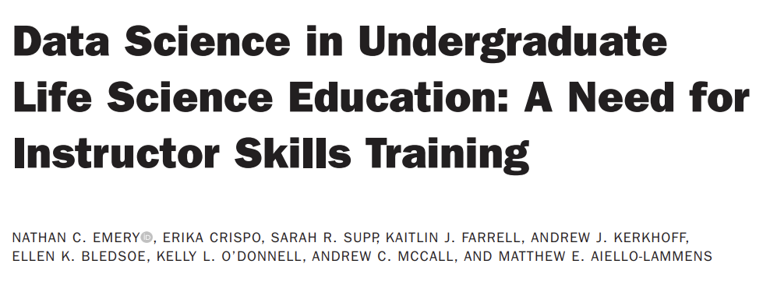
we don’t do it
Frequency of use of data science skills by instructors in their research and nonteaching activities
Queen Mary University of London
Frequently = >1/week, often = 1-2/month, rarely = <2 / term
BioScience, Volume 71, Issue 12, December 2021, Pages 1274–1287, https://doi.org/10.1093/biosci/biab107
Notes:
Nathan Emery (2021). Lots of US respondents, some europe, one china. N=106
Apparently we frequently do data analysis or visualisation. But we rarely bother to make it reproducible.

Slide 14
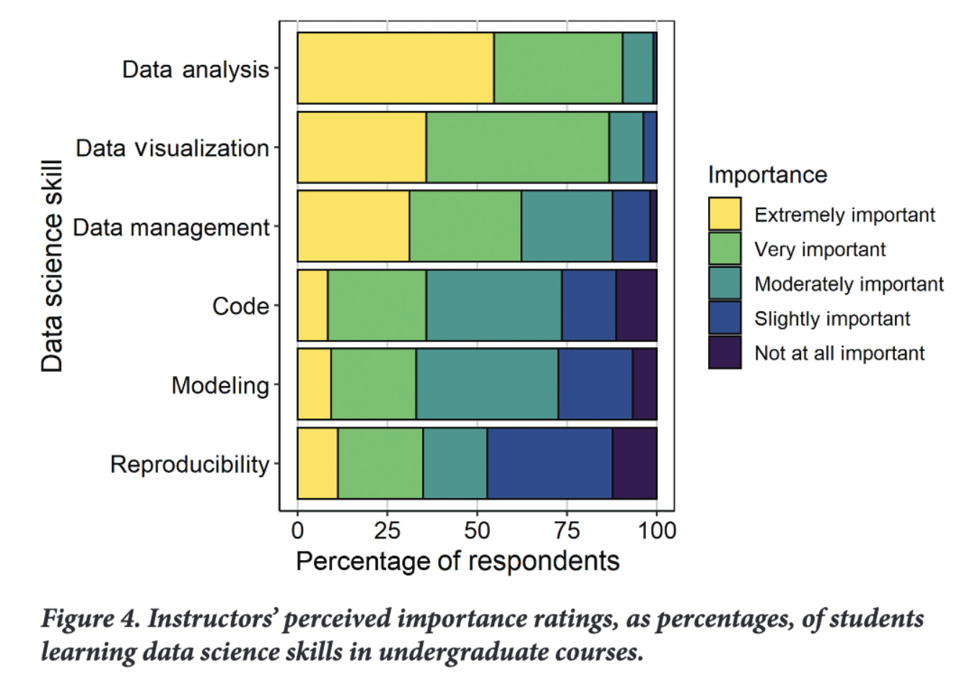
underestimation
BioScience, Volume 71, Issue 12, December 2021, Pages 1274–1287, https://doi.org/10.1093/biosci/biab107
Notes:
And we don’t seem to think it is as important as statistics/visualisation/data skills.

Slide 15
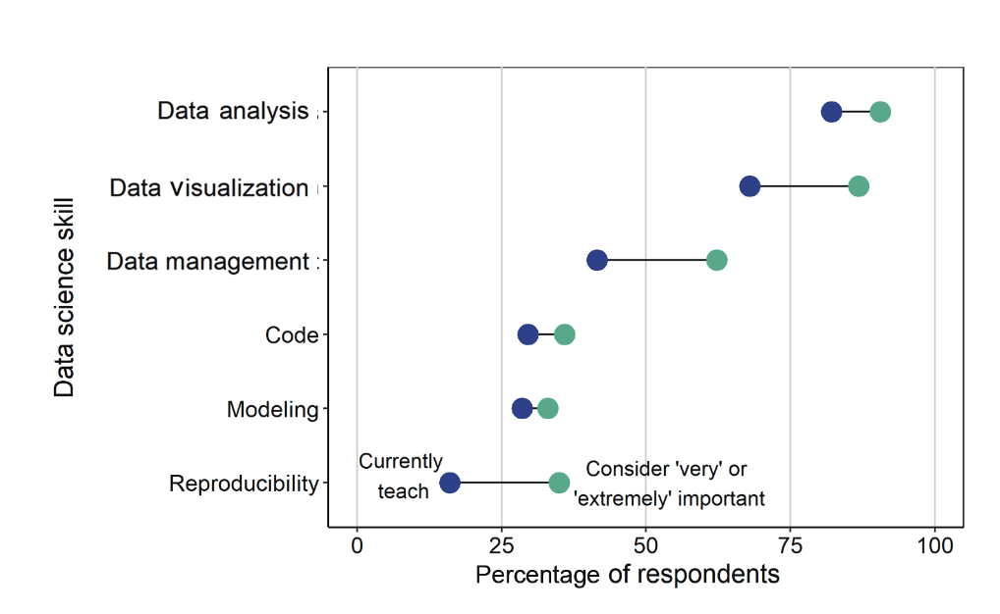
BioScience, Volume 71, Issue 12, December 2021, Pages 1274–1287, https://doi.org/10.1093/biosci/biab107
Notes:
There is some hope : while we do think it should be more. Just not a lot.

Slide 16
Why do we think this?
- one dataset = one answer
- a clear paper is enough
- there is only 1 correct way to do statistics on this
we don’t argue the same about methods & protocols. So bit optimistic there.
Notes:
“ If we just describe we did a mixed model with factors X, Y and Z, sure they can figure it out? There is not that many ways to do that?”
Wrong, there are many ways.
Also, we don’t argue the same about methods & protocols. So bit optimistic there.

Slide 17
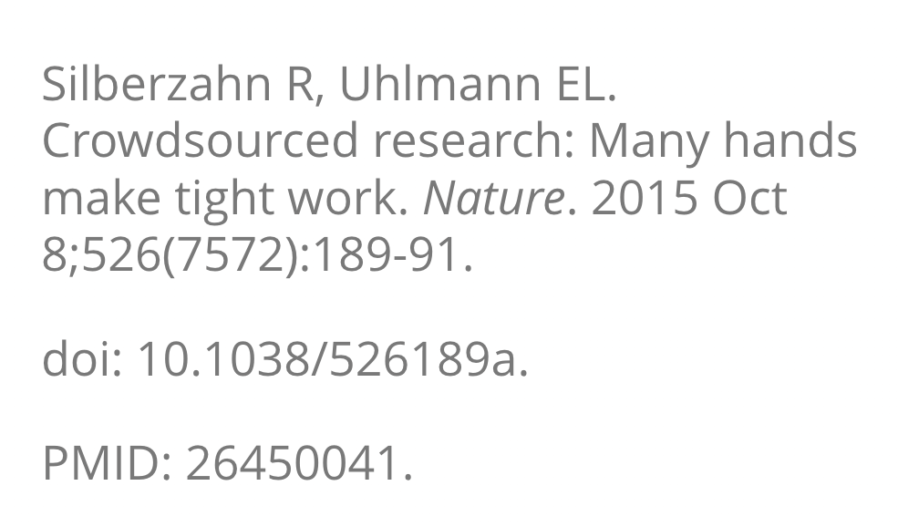
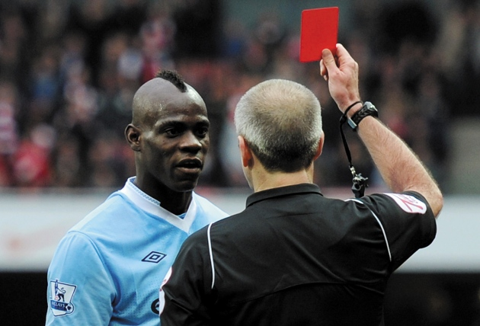
Same data different conclusions
29 research groups, same data, same question:
- Are football (soccer) referees more likely to give red cards to players with dark skin than to players with light skin? -
Review other group’s analyses, discuss
(Michael Regan/Getty images)

Slide 18
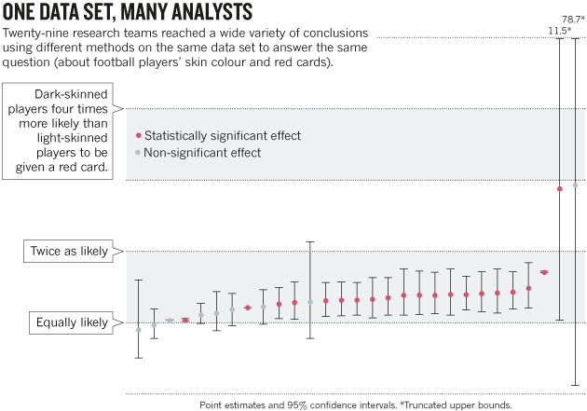
Zelfde data, andere conclusies
results Silberzahn & Uhlmann 2015
Notes:
Note: none of these analyses are wrong
There is no consensus about what should be the ”correct” analysis
So most important is not “do exact X” but “be very clear about what you did exactly” + make that findable.

Slide 19
Same data different conclusions
“Crowdsourcing research can balance discussions, validate findings and better inform policy”
also shows:
- many analytical approaches can be justified
- and lead to wildly different results

Slide 20
My conclusions
- Precise analysis steps/decisions do matter a lot
- if someone else reaches different results from your data, this does not mean you were doing things wrong.
* so we should give them the same credit and coverage as experimental methods

Slide 21
My conclusions
- we should take reproducibility seriously
- we can safely ignore imposter syndrome

Slide 22
“ah, but I write really clear papers”
Notes:
What we ask is to do with analyses as we do with protocols: just put them in the appendix.
Copy paste breaks reproducibility. Do you never ever copy paste?
Also, if you do not include critical reproducibility items such as the code: Future you is still not helped + In silico work depends on it.

Slide 23

“But I work in a commercial company, script = money!”
Notes:
Argument still holds within company walls.
Imagine your coworker leaves for a different job and you need to take over

Slide 24
The how
You will have to change your workflow yourself
With some help we set up
Notes:
But that is a lot easier with a headstart from a pragmatic researcher perspective.
Let’s be fair: We don’t want to spend a few weeks on data standards, learn snakemake and get into discussions with our IT-departments about user rights. We want to do research, communicate about it, and preferably, to be efficient in doing so.

Slide 25
Most important→ minimalise confusion
Project management (tidy work environment)
Literate programming (or even dynamic content generation) (text + analyses in 1 file) +
version control (have just 1 unambiguous file and let the computer track changes) +
dependency management (or at least: communication) (be clear about the software & versions needed to run your code)

Slide 26
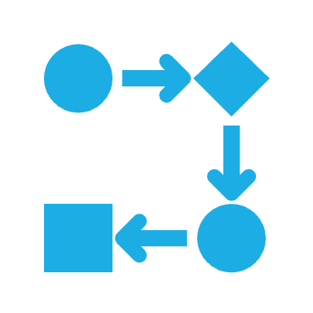
Workflow: prepare your workspace
(the easy one)

Slide 27
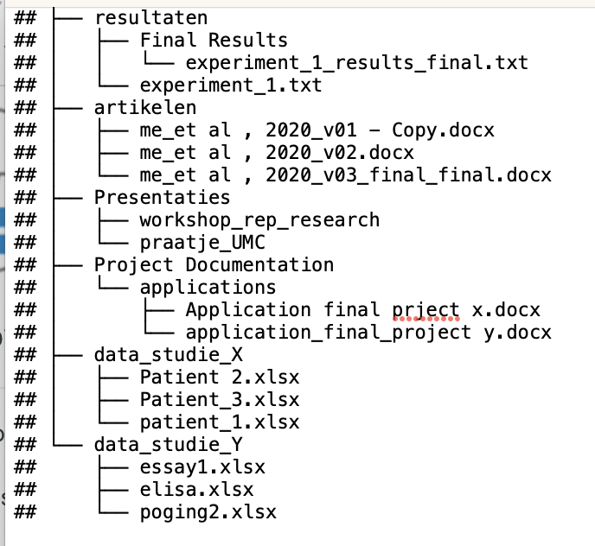
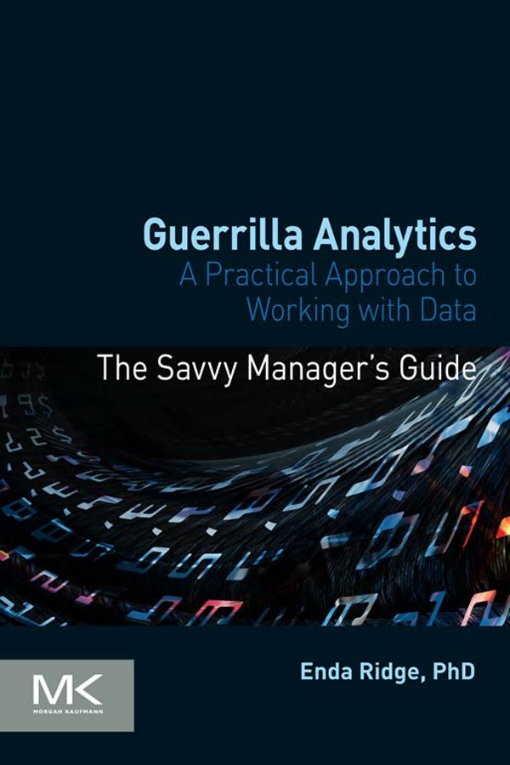
Think in projects not tasks
Notes:
old

Slide 28
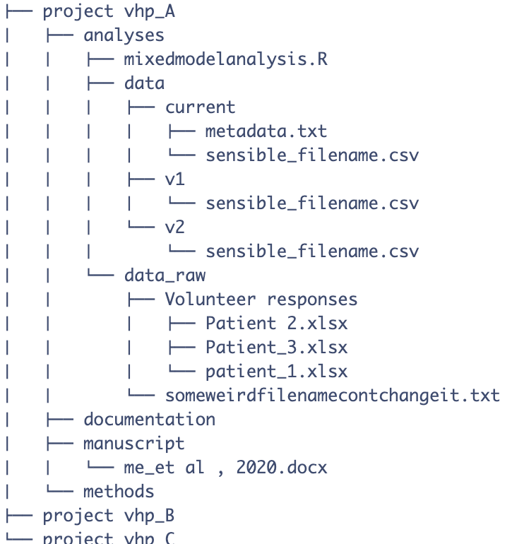
Information about the data (don’t use folder names for meta data!)
Used for analyses
Old version
Never change raw datafiles
(Not even the file names)
Notes:
Better:
Project = folder
Current version of file always on top, previous versions in subfolders
Add meta data files
Don’t touch raw data files

Slide 29
Workflow: data

Slide 30
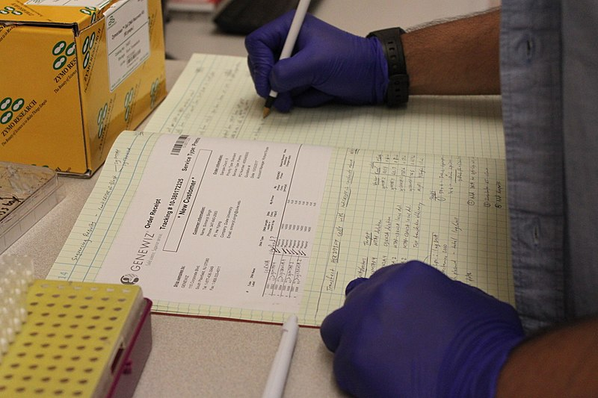
Katherine Stember, CC BY 4.0 , via Wikimedia Commons
Notes:
We write data as if we are still writing on paper

Slide 31
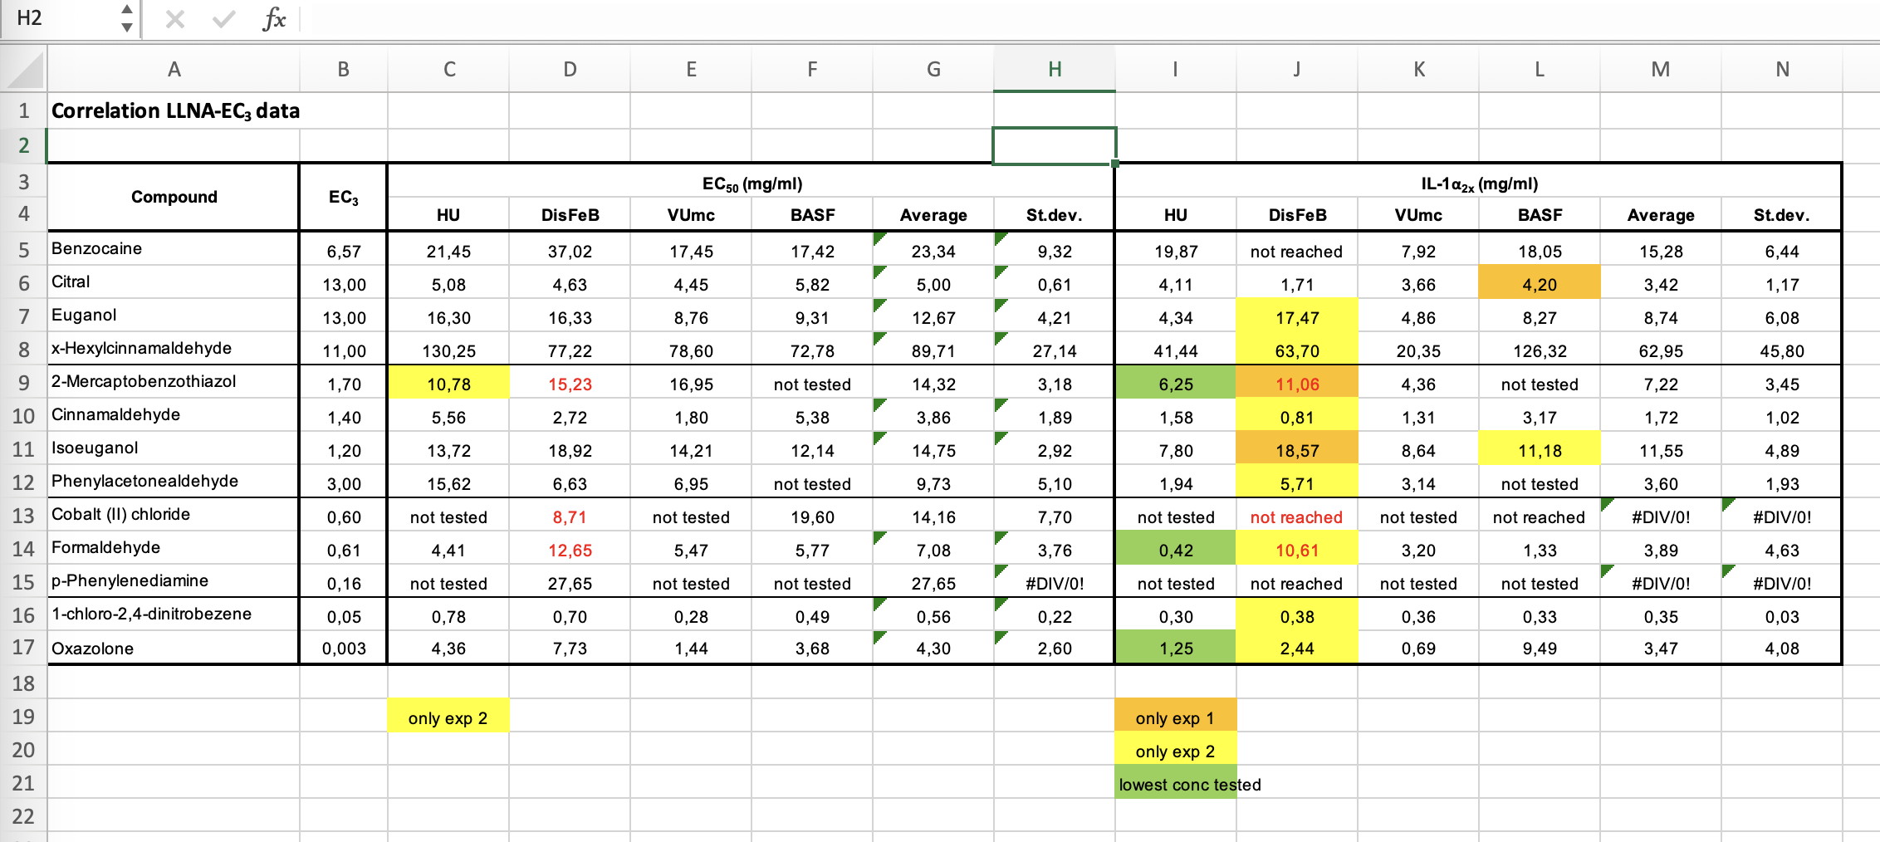
real (messy) data file:
Notes:
We write data as if we are still writing on paper

Slide 32
real (messy) data file:
Bogdanov, Dan & Talviste, Riivo & Willemson, Jan. (2011). Deploying Secure Multi-Party Computation for Financial Data Analysis. IACR Cryptology ePrint Archive. 2011. 662. 10.1007/978-3-642-32946-3_5.
Notes:
But this is a problem. We do not still work on paper. We want AI models to use our data. We want to collaborate over the internet.

Slide 33
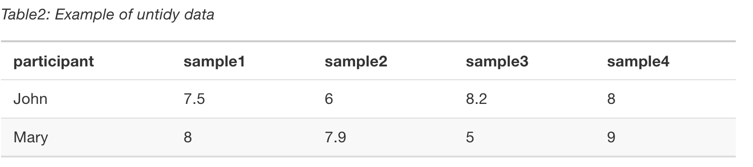
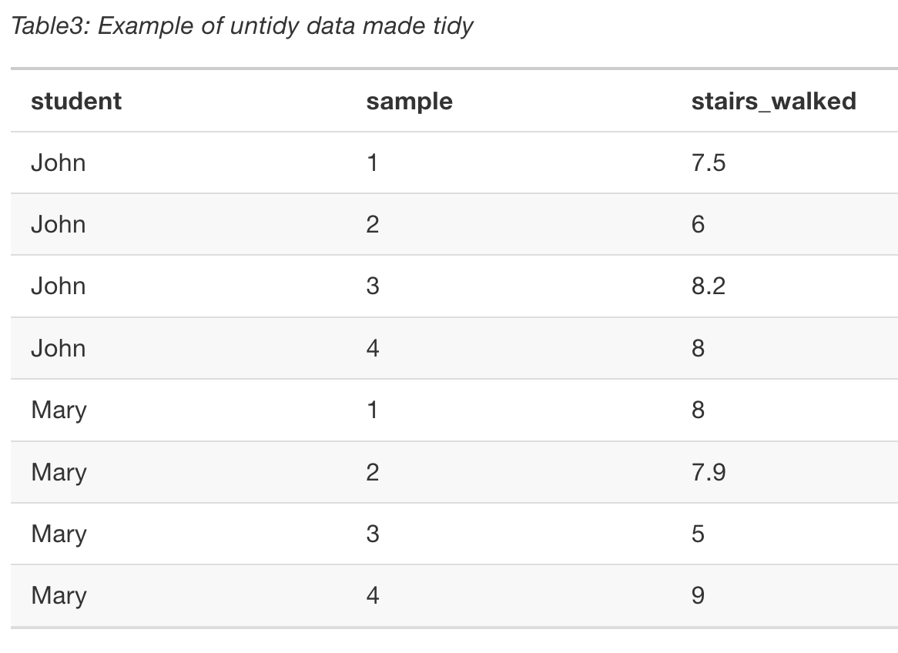
Messy naar tidy
Stairs walked on 4 days
Stairs walked on 4 days
every variable has its own column.
every measurement has a row
One (1) value / cell
Tidy data = machine readable
Notes:
Tot 13:00

Slide 34
task
Reminder of the rules:
project = folder .
consistent folder structure
Do not deep nest folders more than needed
Don’t use folder names to keep meta data
Keep information about the data, close to the data.
Store each dataset in its own sub-folder.
Do not change file names
Do not manually edit data source files. Ever.
In code, use relative paths
Take your agenda and plan 1 hour+ somewhere in September/October to tidy your current projects.
- folders (template folders available in the github repo for this course)
- data!

Slide 35
Workflow: analyse and write

Slide 36
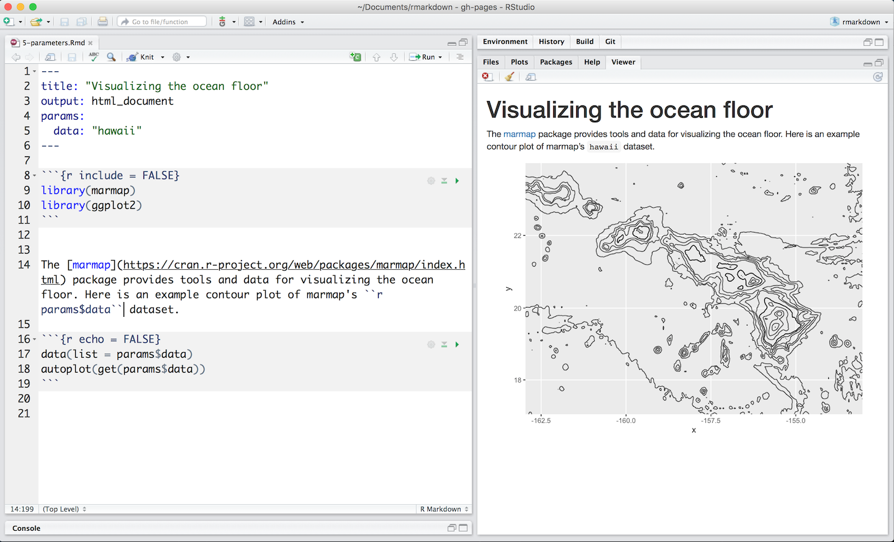
Reproduceerbare data analyse
One file to connect them all
Notes:
Literate programming: all information and connection in 1 file

Slide 37
Code along
Open the lit programming template project folder
Open the .Rmd file
Packages used by me:
tinytex (latex)
rticles (paper templates)
Reticulate (to use Python)

Slide 38
Workflow: change things

Slide 39
Version control
use the folder structure provided
always keep current version on top
Keep old versions in subfolders
Next step: Use github!
Does the version control for you
Makes it easier to share
(Cannot host large data files)
We do online crash courses for free, come join us
Notes:
Show github repo live

Slide 40
Workflow: share
“here is a link to the github repo”
Or at least:
“here is a zip of my current project folder”
Share all info, not only data!

Slide 41
links
Guerilla analytics: https://guerrilla-analytics.net/
R4datascience: https://r4ds.hadley.nz/
Python for everybody: https://www.py4e.com/

